Slide 1
Docker Brown Bag
Michael Simons (msimons)

Slide 2
Assumption
Everyone knows the problem Docker is solving and Docker basics

Slide 3
Why Docker vs VM
Dockerfile captures the definition
Easy to build
Easy to iterate
Portable
Size
If each VM is 10Gb in size, then 10 VMs will take up 10x10 = 100Gb of resources
Take a 10Gb container and run ten of them, or even a hundred, and you won't use anything close to 100Gb of resources.
Speed
Notes:
Dockerfile is geniusly simple
Best ideas are the simple ones that are well delivered.
DevOps IT industry gets it – we should be paying attention.

Slide 4
Image vs Container

Slide 5
Image
A template (application plus required binaries and libraries)
Immutable
Defined via a Dockerfile (Ideally)

Slide 6
Container
A running instance of an image
Writable layer on top of an image
Intended to be ephemeral
Can have * instances of an image running concurrently

Slide 7
Docker Layers

Slide 8
Docker Layers
Each image consists of a series of layers
Union file systems allows common layers to be shared between images and containers
One of the reasons Docker is so lightweight
Notes:
Docker images are read-only templates from which Docker containers are instantiated. Each image consists of a series of layers. Docker uses union file systems to combine these layers into a single image. Union file systems allow files and directories of separate file systems, known as branches, to be transparently overlaid, forming a single coherent file system.
These layers are one of the reasons Docker is so lightweight. When you change a Docker image, such as when you update an application to a new version, a new layer is built and replaces only the layer it updates. The other layers remain intact. To distribute the update, you only need to transfer the updated layer. Layering speeds up distribution of Docker images and reduces the disk space required to host containers. Docker determines which layers need to be updated at runtime.

Slide 9
Docker Layers
Image 1
dotnetbot binaries
Image 2
dotnetbot source
whalesay binaries
Image 3
Image 4
.NET Core SDK
dotnetbot binaries
dotnetbot binaries
.NET Core Runtime
.NET Core Runtime
Windows Nano Server (10.0.14393.693)
Ubuntu 16.04
Notes:
Anteres – high disk density

Slide 10
Dockerfile
Dockerfile is the set of instructions that define the image.
Every image starts from a base image. The base image is defined using the FROM keyword in the Dockerfile.
Each instruction creates a new layer in the image.
Building a Dockerfile executes the instructions to produce an image.
Notes:
Using docker build users can create an automated build that executes several command-line instructions in succession.
https://docs.docker.com/engine/reference/builder/

Slide 11
Docker history
IMAGE CREATED CREATED BY SIZE
48e3f964cc7a 6 days ago /bin/sh -c #(nop) ENTRYPOINT ["dotnet" "d... 0B
7e208544fd80 6 days ago /bin/sh -c #(nop) COPY dir:2a226c263ba3d17... 9.79kB
8f0dc8d699dd 6 days ago /bin/sh -c #(nop) WORKDIR /app 0B
288f93ad94af 12 days ago /bin/sh -c curl -SL $DOTNET_DOWNLOAD_URL -... 32.5MB
<missing> 12 days ago /bin/sh -c #(nop) ENV DOTNET_DOWNLOAD_SHA... 0B
<missing> 12 days ago /bin/sh -c #(nop) ENV DOTNET_DOWNLOAD_URL... 0B
<missing> 12 days ago /bin/sh -c #(nop) ENV DOTNET_VERSION=2.0.0 0B
<missing> 12 days ago /bin/sh -c apt-get update && apt-get i... 1.38MB
<missing> 12 days ago /bin/sh -c apt-get update && apt-get i... 45.4MB
<missing> 5 weeks ago /bin/sh -c #(nop) CMD ["bash"] 0B
<missing> 5 weeks ago /bin/sh -c #(nop) ADD file:5b66635869fca4e... 85.7MB

Slide 12
Layer Optimization Problem
FROM debian:jessie
# Install .NET Core
ENV DOTNET_VERSION 2.0.0
ENV DOTNET_DOWNLOAD_URL https://dotnetcli.blob.core.windows.net/...
RUN curl -SL $DOTNET_DOWNLOAD_URL --output dotnet.tar.gz
RUN mkdir -p /usr/share/dotnet
RUN tar -zxf dotnet.tar.gz -C /usr/share/dotnet
RUN ln -s /usr/share/dotnet/dotnet /usr/bin/dotnet

Slide 13
Any Better?
FROM debian:jessie
# Install .NET Core
ENV DOTNET_VERSION 2.0.0
ENV DOTNET_DOWNLOAD_URL https://dotnetcli.blob.core.windows.net/...
RUN curl -SL $DOTNET_DOWNLOAD_URL --output dotnet.tar.gz
RUN mkdir -p /usr/share/dotnet
RUN tar -zxf dotnet.tar.gz -C /usr/share/dotnet
++ RUN rm dotnet.tar.gz
RUN ln -s /usr/share/dotnet/dotnet /usr/bin/dotnet

Slide 14
Solution
FROM debian:jessie
# Install .NET Core
ENV DOTNET_VERSION 2.0.0
ENV DOTNET_DOWNLOAD_URL https://dotnetcli.blob.core.windows.net/...
RUN curl -SL $DOTNET_DOWNLOAD_URL --output dotnet.tar.gz \
&& mkdir -p /usr/share/dotnet \
&& tar -zxf dotnet.tar.gz -C /usr/share/dotnet \
&& rm dotnet.tar.gz \
&& ln -s /usr/share/dotnet/dotnet /usr/bin/dotnet

Slide 15
Build Layer Caching
Docker build will utilize image cache when possible
Each Dockerfile instruction has its own caching semantics
--no-cache will ignore cache
Notes:
During the process of building an image Docker will step through the instructions in your Dockerfile executing each in the order specified. As each instruction is examined Docker will look for an existing image in its cache that it can reuse, rather than creating a new (duplicate) image. If you do not want to use the cache at all you can use the --no-cache=true option on the docker build command.
However, if you do let Docker use its cache then it is very important to understand when it will, and will not, find a matching image. The basic rules that Docker will follow are outlined below:
Starting with a parent image that is already in the cache, the next instruction is compared against all child images derived from that base image to see if one of them was built using the exact same instruction. If not, the cache is invalidated.
In most cases simply comparing the instruction in the Dockerfile with one of the child images is sufficient. However, certain instructions require a little more examination and explanation.
For the ADD and COPY instructions, the contents of the file(s) in the image are examined and a checksum is calculated for each file. The last-modified and last-accessed times of the file(s) are not considered in these checksums. During the cache lookup, the checksum is compared against the checksum in the existing images. If anything has changed in the file(s), such as the contents and metadata, then the cache is invalidated.
Aside from the ADD and COPY commands, cache checking will not look at the files in the container to determine a cache match. For example, when processing a RUN apt-get -y update command the files updated in the container will not be examined to determine if a cache hit exists. In that case just the command string itself will be used to find a match.
Once the cache is invalidated, all subsequent Dockerfile commands will generate new images and the cache will not be used.

Slide 16
What is wrong?
FROM microsoft/dotnet:2.0-sdk
WORKDIR /app
COPY . ./
RUN dotnet restore
RUN dotnet publish -c Release -o out
ENTRYPOINT ["dotnet", "out/dotnetapp.dll"]

Slide 17
Solution
FROM microsoft/dotnet:2.0-sdk
WORKDIR /app
# restore packages before copying entire source
COPY *.csproj ./
RUN dotnet restore
# copy and build everything else
COPY . ./
RUN dotnet publish -c Release -o out
ENTRYPOINT ["dotnet", "out/dotnetapp.dll"]

Slide 18
Docker Tags

Slide 19
What are they?
Image identifier
[REGISTRYHOST/][OWNER/]NAME[:TAG]
docker.io/microsoft/dotnet:2.0-sdk
dotnetcore-microsoft.azurecr.io/build_prereqs:ubuntu.14.04
microsoft/dotnet:2.0-sdk
microsoft/dotnet
microsoft/dotnet:latest
msimons/docker-toolbox:image-builder
debian:jessie
Specified via –t when building
Docker build –t myimage .

Slide 20
Versioning Tags
Image x
1.0.0, 1.0, 1, latest

Slide 21
Versioning Tags
Image x
1.0.0
Image x²
1.0.1, 1.0, 1, latest

Slide 22
Versioning Tags
Image x
1.0.0
Image x²
1.0.1, 1.0
Image x³
1.1.0, 1.1, 1, latest

Slide 23
Versioning Tags
Image x
1.0.0
Image x²
1.0.1, 1.0
Image x³
1.1.0, 1.1, 1
Image x⁴
2.0.0, 2.0, 2, latest

Slide 24
Not all images are tagged
-t is an option
Dangling images
docker build multiple times
Previous image is dangling
Removing images is explicit
REPOSITORY TAG IMAGE ID SIZE
microsoft/dotnet-samples dotnetapp 48e3f964cc7a 165MB
microsoft/dotnet-samples dotnetapp-stretch-arm32v7 48e3f964cc7a 165MB
microsoft/dotnet-samples latest 48e3f964cc7a 165MB
microsoft/dotnet-samples dotnetapp-stretch 4ae0a48467db 219MB
<none> <none> f8e18accccd8 1.63GB

Slide 25
Clean them up
Image management is important
Monitor
docker images
docker system df
Dangling images must be addressed
docker system prune

Slide 26
Docker Registry

Slide 27
Docker Hub / Docker Store
Implementations of a Docker Registry
Storage for your images
Free for public images
Cost for private images
Provides services
Automated build infrastructure (linked to SCC; triggered by commits)
Security analysis
Automated Deployment
Notes:
Docker Hub is the old
Docker Store is the new
Still in transition
Docker Store cost $
Monetizing compute

Slide 28
Usage
Images are implicitly pulled during docker build/run
docker run –rm microsoft/dotnet-samples
Only occurs if image is not found locally
Never updates existing image
Tags can get updated on Docker Registry
docker pull to explicitly get newest image
Use –pull option when building
Use digest to lock image
FROM ubuntu:14.04
FROM ubuntu@sha256:45b23dee08...

Slide 29
Docker Volumes

Slide 30
What about data persistence?
Volumes allow you to specify a directory in the container that exists outside of the docker file system structure
Can be used to share (and persist) data between containers
Directory persists after the container is deleted
Unless you explicitly delete it

Slide 31
Types
Local Path
docker run –v /mydata:/working …
Must share in Docker for Windows
Docker Volume
docker run –v mydata:/working …
Created automatically if doesn’t exist
Managed via Docker CLI

Slide 32
Multi-Stage Dockerfiles
Supports effective creation of optimal Docker images

Slide 33
Dockerfile.build
FROM microsoft/dotnet:2.0-sdk
WORKDIR /app
COPY dotnetapp.csproj .
RUN dotnet restore
COPY . .
RUN dotnet publish -c Release -o out

Slide 34
Dockerfile
FROM microsoft/dotnet:2.0-runtime
WORKDIR /app
COPY out .
ENTRYPOINT ["dotnet", "dotnetapp.dll"]

Slide 35
Bridge the Dockerfiles
docker build -t build-image -f Dockerfile.build .
docker create --name build-container build-image
docker cp build-container:/app/out ./
docker rm build-container
docker build -t app-image .

Slide 36
Multi-stage Dockerfile
FROM microsoft/dotnet:2.0-sdk AS build-env
WORKDIR /app
COPY *.csproj ./
RUN dotnet restore
COPY . ./
RUN dotnet publish -c Release -o out
# build runtime image
FROM microsoft/dotnet:2.0-runtime
WORKDIR /app
COPY --from=build-env /app/out ./
ENTRYPOINT ["dotnet", "dotnetapp.dll"]

Slide 37
Multi-Stage Dockerfile Details
Multiple FROM commands within a single Dockerfile
AS keyword allows aliasing of stages
COPY –from supports referencing context of previous stages
ARG usage support within the FROM commands
-target option allows you to build a particular stage
Docker has no smarts to determine build graph – builds everything prior.
No support to tag individual stages.

Slide 38
Cross Platform Scenario
Platform is not just OS. Chip architecture is also a form of cross platform.
.NET Core SDK doesn’t support arm
How can you use Docker to build an optimized runtime image?

Slide 39
Multiple Machine Option
Build app within Dockerfile on amd host
Copy output to arm
Build runtime image on Arm

Slide 40
Multi-Stage Dockerfile Option
FROM microsoft/dotnet:2.0-sdk AS build-env
WORKDIR /app
COPY *.csproj ./
RUN dotnet restore
COPY . ./
RUN dotnet publish -c Release -o out
# build runtime image
FROM microsoft/dotnet:2.0.0-runtime-stretch-arm32v7
WORKDIR /app
COPY --from=build-env /app/out ./
ENTRYPOINT ["dotnet", "dotnetapp.dll"]

Slide 41
Specifics
Only works on Docker for Windows and Docker for Mac
Docker Hypervisor capable of spinning up different hosts (amd/arm)

Slide 42
Multi-Arch Tags

Slide 43
Problem
Suppose you are reading a blog that talks about this new programming platform that is changing the industry.
Blog states you can easily try it out with a Docker image
Try it out on Docker for Windows
Error: image operating system “linux" cannot be used on this platform
Turns out there is a different tag per supported platform
How many users give up before they discover this?

Slide 44
Solution
One tag no matter the platform
docker pull microsoft/dotnet:2.0-runtime
Windows amd64
Linux amd64
Linux arm32
…
Achieved via manifest
Client platform manifest lookup occurs on pull

Slide 45
Q & A

Slide 46
Market View: Evolution of IT
1995
2015
Thin app on mobile, tablet
Thick, client-server app on thick client
Well-defined stack:
- O/S
- Runtime
- Middleware
Assembled by developers using best available services
Running on any available set of physical resources
(public/private/
virtualized)
Monolithic
Physical
Infrastructure

Slide 47
Challenges
2015
Thin app on mobile, tablet
Assembled by developers using best available services
How to ensure services interact consistently, avoid dependency hell
How to avoid n X n different configs
Running on any available set of physical resources
(public/private/
virtualized)
How to migrate & scale quickly, ensure compatibility

Slide 48

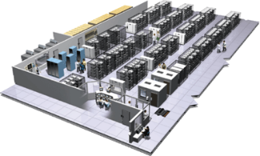
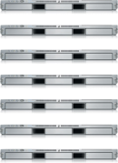
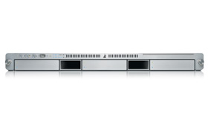
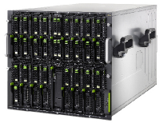

The Challenge
User DB
Static website
Queue
Analytics DB
Do services and apps interact appropriately?
Multiplicity of Stacks
Background workers
Web frontend
API endpoint
Production Cluster
Development VM
Public Cloud
Multiplicity of hardware environments
Can I migrate smoothly and quickly?
QA server
Disaster recovery
Customer Data Center
Contributor’s laptop
Production Servers

Slide 49
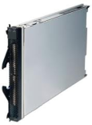
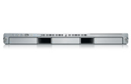
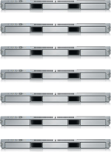


Results in N X N compatibility nightmare
? | ? | ? | ? | ? | ? | ?
? | ? | ? | ? | ? | ? | ?
? | ? | ? | ? | ? | ? | ?
? | ? | ? | ? | ? | ? | ?
? | ? | ? | ? | ? | ? | ?
? | ? | ? | ? | ? | ? | ?
Static website
Web frontend
Background workers
User DB
Analytics DB
Queue
 | Development VM | QA Server | Single Prod Server | Onsite Cluster | Public Cloud | Contributor’s laptop | Customer Servers

Slide 50
A useful analogy…

Slide 51
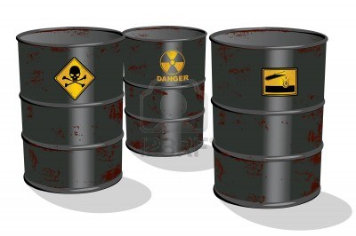
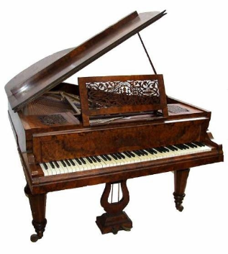

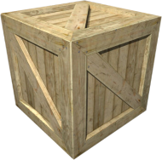
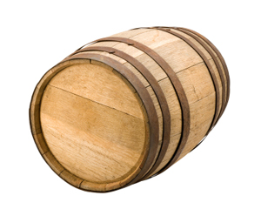
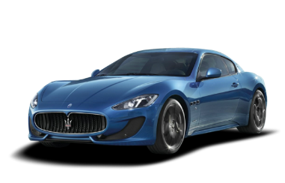
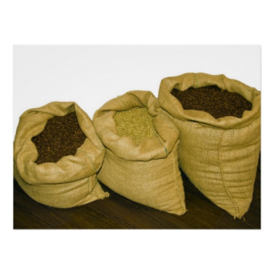



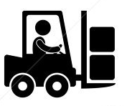
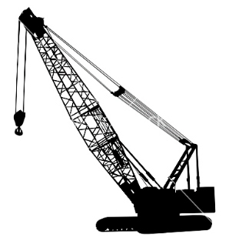
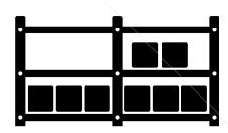

Cargo Transportation Pre-1960
Do I worry about how goods interact (e.g. coffee beans next to spices)
Multiplicity of Goods
Can I transport quickly and smoothly
(e.g. from boat to train to truck)
Multiplicity of methods for transporting/storing

Slide 52
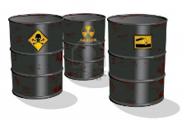




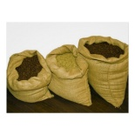


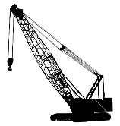



NxN Matrix
 | ? | ? | ? | ? | ? | ? | ?
 | ? | ? | ? | ? | ? | ? | ?
 | ? | ? | ? | ? | ? | ? | ?
 | ? | ? | ? | ? | ? | ? | ?
 | ? | ? | ? | ? | ? | ? | ?
 | ? | ? | ? | ? | ? | ? | ?

Slide 53

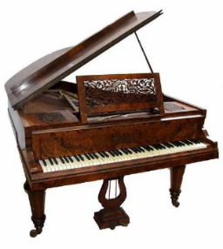

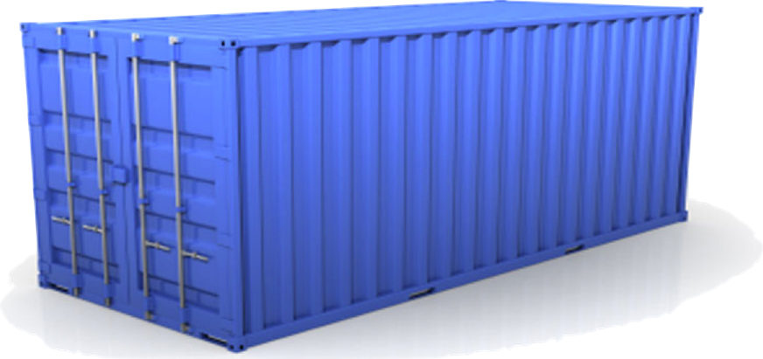
Solution: Intermodal Shipping Container
Do I worry about how goods interact (e.g. coffee beans next to spices)
Multiplicity of Goods
A standard container that is loaded with virtually any goods, and stays sealed until it reaches final delivery.
…in between, can be loaded and unloaded, stacked, transported efficiently over long distances, and transferred from one mode of transport to another
Can I transport quickly and smoothly
(e.g. from boat to train to truck)
Multiplicity of methods for transporting/storing

Slide 54


This eliminated the NXN problem…

Slide 55
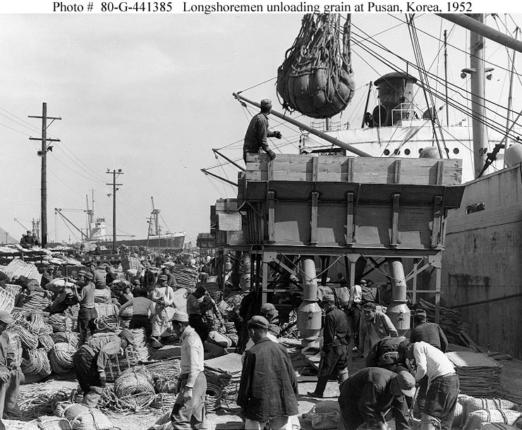
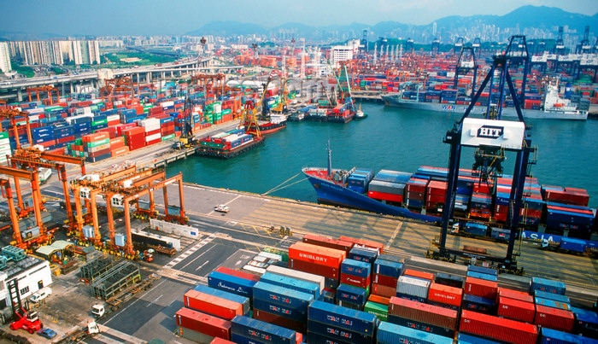
and spawned an Intermodal Shipping Container Ecosystem
90% of all cargo now shipped in a standard container
Order of magnitude reduction in cost and time to load and unload ships
Massive reduction in losses due to theft or damage
Huge reduction in freight cost as percent of final goods (from >25% to <3%)
massive globalizations
5000 ships deliver 200M containers per year

Slide 56
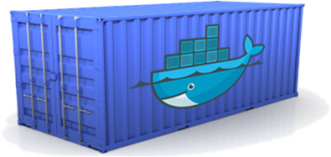
Docker is a shipping container system for code
Static website
User DB
Web frontend
Queue
Analytics DB
Do services and apps interact appropriately?
Multiplicity of Stacks
An engine that enables any payload to be encapsulated as a lightweight, portable, self-sufficient container…
…that can be manipulated using standard operations and run consistently on virtually any hardware platform
Multiplicity of hardware environments
Can I migrate smoothly and quickly
Development VM
QA server
Customer Data Center
Public Cloud
Production Cluster
Contributor’s laptop

Slide 57
Or…put more simply
Static website
User DB
Web frontend
Queue
Analytics DB
Do services and apps interact appropriately?
Multiplicity of Stacks
Developer: Build Once, Run Anywhere (Finally)
Operator: Configure Once, Run Anything
Multiplicity of hardware environments
Can I migrate smoothly and quickly
Development VM
QA server
Customer Data Center
Public Cloud
Production Cluster
Contributor’s laptop

Slide 58
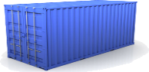
Docker solves the NXN problem
Static website
Web frontend
Background workers
User DB
Analytics DB
Queue
 | Development VM | QA Server | Single Prod Server | Onsite Cluster | Public Cloud | Contributor’s laptop | Customer Servers

Slide 59
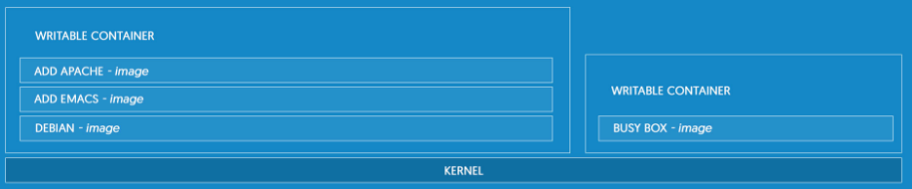
What is docker
Docker is the world's leading software containerization platform
Lightweight
Open
Secure By Default
Notes:
Docker is the world's leading software containerization platform
Docker containers wrap a piece of software in a complete filesystem that contains everything needed to run: code, runtime, system tools, system libraries – anything that can be installed on a server. This guarantees that the software will always run the same, regardless of its environment.
LIGHTWEIGHT
Containers running on a single machine share the same operating system kernel; they start instantly and use less RAM. Images are constructed from layered filesystems and share common files, making disk usage and image downloads much more efficient.
OPEN
Docker containers are based on open standards, enabling containers to run on all major Linux distributions and on Microsoft Windows -- and on top of any infrastructure.
SECURE BY DEFAULT
Containers isolate applications from one another and the underlying infrastructure, while providing an added layer of protection for the application.

Slide 60
VIRTUAL MACHINES vs CONTAINERS
Notes:
Containers and virtual machines have similar resource isolation and allocation benefits -- but a different architectural approach allows containers to be more portable and efficient.
VIRTUAL MACHINES
Virtual machines include the application, the necessary binaries and libraries, and an entire guest operating system -- all of which can amount to tens of GBs.
CONTAINERS
Containers include the application and all of its dependencies --but share the kernel with other containers, running as isolated processes in user space on the host operating system. Docker containers are not tied to any specific infrastructure: they run on any computer, on any infrastructure, and in any cloud. No UI

Slide 61
BUILD BETTER SOFTWARE
Skip the setup and maintenance of development environments and language-specific tooling.
Accelerate Developers
Empower Creativity
Eliminate Environment Inconsistencies
Notes:
Skip the setup and maintenance of development environments and language-specific tooling. Focus on creating new features, fixing issues, and shipping software.
ACCELERATE DEVELOPERS
Stop wasting hours setting up developer environments, spinning up new instances, and making copies of production code to run locally. With Docker, you simply take copies of your live environment and run them on any new endpoint running a Docker engine.
EMPOWER CREATIVITY
The isolation capabilities of Docker containers free developers from constraints: they can use the best language and tools for their application services without worrying about causing internal tooling conflicts.
ELIMINATE ENVIRONMENT INCONSISTENCIES
Packaging an application in a container with its configs and dependencies guarantees that the application will always work as designed in any environment: locally, on another machine, in test or production. No more worries about having to install the same configurations into different environments.

Slide 62
SHARE AND COLLABORATE
Docker creates a common framework for developers and sysadmins to work together on distributed applications
Easy Content Distribution
Share Content (Automatically)
Notes:
Docker creates a common framework for developers and sysadmins to work together on distributed applications
DISTRIBUTE & SHARE CONTENT
Store, distribute, and manage Docker images in Docker Hub with your team. Image updates, changes, and history are automatically shared across your organization.

Slide 63
SHIP SOFTWARE FASTER AND AT SCALE
Docker allows you to dynamically change your application -- from adding new capabilities, to quickly changing problem areas.
Ship 7X More
Quickly Scale
Notes:
Docker allows you to dynamically change your application -- from adding new capabilities, to quickly changing problem areas.
SHIP 7X MORE
On average, Docker users ship 7X more software after deploying Docker in their environment. More frequent software updates provide added value to customers.
QUICKLY SCALE
Docker containers spin up and down in seconds, making it easy to scale application services to satisfy peak customer demand, and then reduce running containers when demand ebbs.

Slide 64
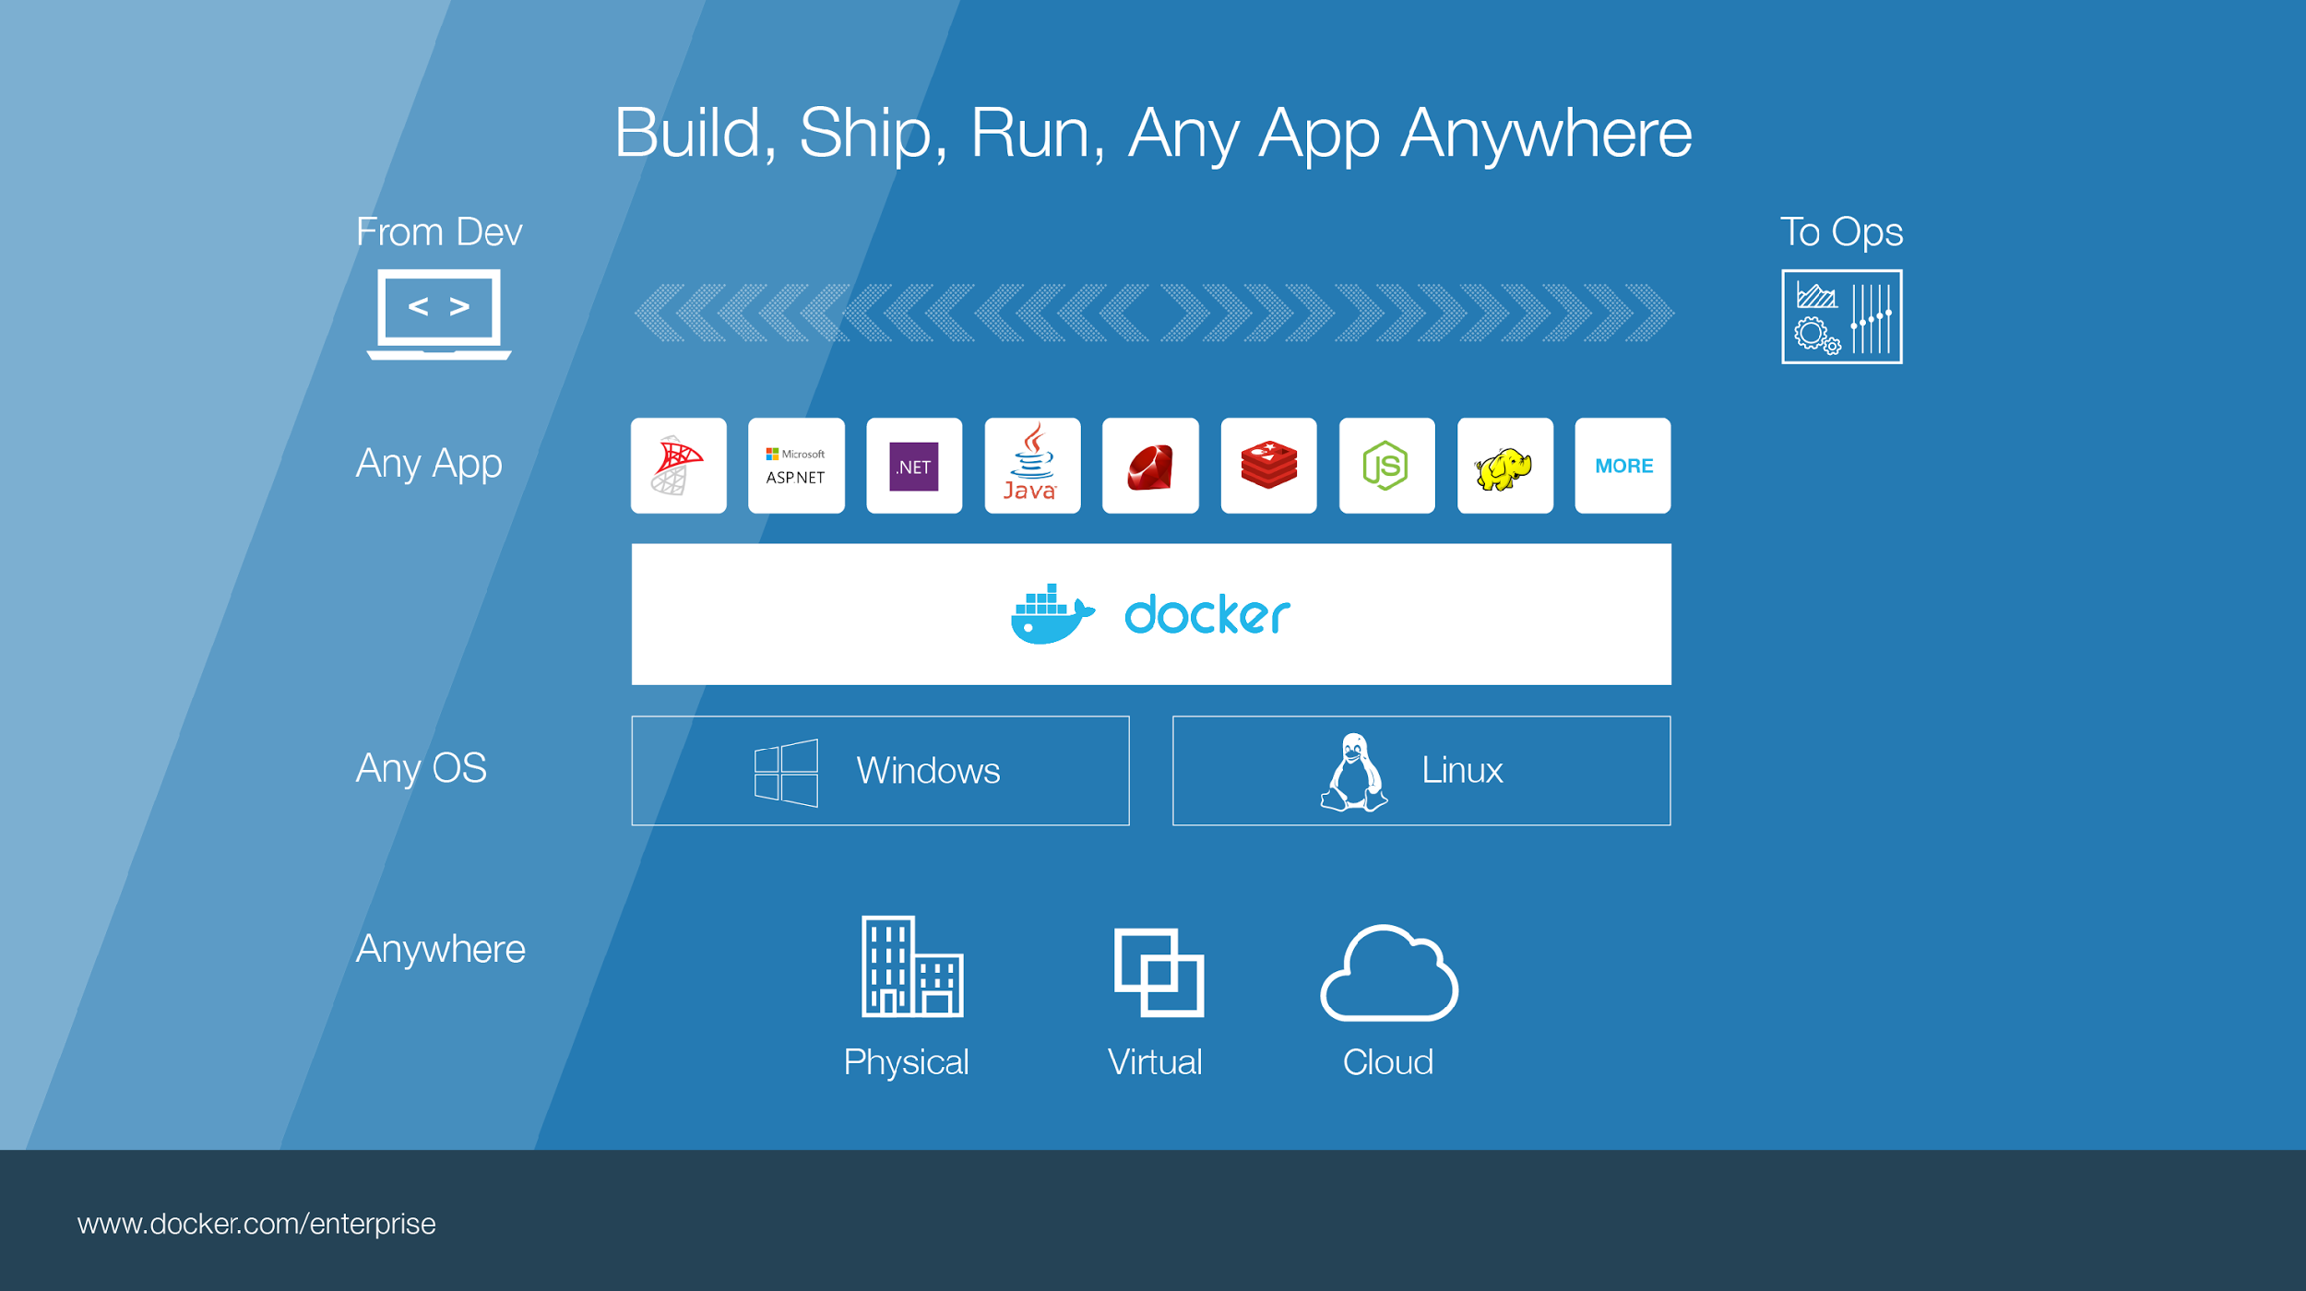
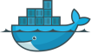
Notes:
Build, Ship, Run – Any App Anywhere – that’s Docker’s slogan
But, what does it mean?
What it essentially boils down to is that developers can choose whatever language or components they want to build their application – .Net, ASP, Java, Ruby, Redis, etc across both the Linux and Windows ecosystem. They are assured that whatever they code up, it will run wherever the Ops team chooses to deploy it – Physical, virtual, or cloud – it makes no difference to Docker.
An application written on a developers laptop will run exactly the same on the largest bare metal servers, in the cloud, even on a Raspberry Pi in my den.
Move applications seamlessly from dev to test to production.
Talk about linux vs Windows – Windows containers are windows only specific
Nano Server, which offers a minimal-footprint headless version of Windows Server
Windows Server, light UI version of Windows Server
Microsoft announced a new installation option, Nano Server, which offers a minimal-footprint headless version of Windows Server. It excludes the graphical user interface, WoW64 (support for 32-bit software) and Windows Installer. It does not support console login, either locally or via Remote Desktop Connection. All management is performed remotely via Windows Management Instrumentation (WMI), Windows PowerShell and Remote Server Management Tools (a collection of web-based GUI and command line tools).^{[25]} However, in Technical Preview 5, Microsoft has re-added the ability to administer Nano Server locally through PowerShell. According to Microsoft engineer Jeffrey Snover, Nano Server has 93% lower VHD size, 92% fewer critical security advisories, and 80% fewer reboots than Windows Server.^{[26][27]}

